Slide 1
Fiscal Year 2025 SEFA Reporting Training
Welcome To
Schedule of Expenditures of Federal Awards

Slide 2
FY 2025 Financial Reporting Branch staff
Joe McDaniel
Controller
Joe.McDaniel@ky.gov
502-564-5120
Christina Shuffett-Powell
Federal Fund Accountant
Christina.Shuffett@ky.gov
502-564-5125
Jason Salazar Munoz Auditor IV
Jason.Salazar-Munoz@ky.gov
502-782-2590
Gina Shall
Auditor IV
GinaC.Shall@ky.gov
502-564-7229
Pam Howarah
Auditor IV
Pam.Howarah@ky.gov502-782-6885
Carolyn Noplis
Contractor
Carolyn.Noplis@ky.gov
502-784-2872
DeeDee McCrosky
Contractor
DeeDee.McCrosky@ky.gov
502-564-7752
Jackie Green
Contractor
Jackie.Green@ky.gov
502-564-8790
Phil Nally
Contractor
Phil.Nally@ky.gov
502-564-2994

Slide 3
Continuing Education Credit
Today’s training qualifies for one CPE credit in Governmental Accounting for Fiscal Year 2025.
To earn the CPE credit, and to document your training in My Purpose, your participation must be verified using the Microsoft form link below:
https://forms.office.com/Pages/ResponsePage.aspx?id=TX9812fXH0a2JQYoeS6eKoWBDVXSkpdKp9nHI-dKk7hUQlFYVTFJUkZVQkI1MElMWEpHODQ0UEYzQi4u
A CPE certificate will be emailed to all verified participants requesting the certification.
CPE credit is not available by viewing a recording of this presentation.

Slide 4
Housekeeping Notes
Mute your microphone.
Turn off your camera.
Utilize the chat for questions/comments you wish to make during the training.
There are Q&A sessions after each section of a SEFA Form.
During the Q&A sessions please use the hand-raise reaction, located in the top ribbon of the TEAMS window, to alert the moderator.
During your Q&A unmute yourself to comment. Mute your microphone once your question has been asked.

Slide 5
ALN 21.027 for Fiscal Year 2025
Some State Agencies receive federal funding through ALN 21.027 - Coronavirus State and Local Fiscal Recovery Funds (SLFRF).
SLFRF funds notice, concerning the obligation of these funds, was issued March 2025 and is linked below: ..\March-2025-Notice-SLFRF Funds.pdf
This may impact SEFA reporting as it relates to Beneficiaries, Subrecipients and Pass-throughs.
Documentation should be thoroughly reviewed by your Agency to follow the guidelines for compliance with reporting of ALN 21.027 funds on the Schedule of Federal Awards (SEFA).
**The link below will take you to the Frequently Asked Questions page related to SLFRF Funding. This documentation is also available on FAC’s website, shown below:
https://finance.ky.gov/office-of-the-controller/office-of-statewide-accounting-services/financial-reporting-branch/Documents/SLFRF-Final-Rule-FAQ.pdf
Should your agency have questions concerning SLFRF funding, please reach out to FAC’s SEFA personnel.

Slide 6
WHAT is SEFA
The Schedule of Expenditure of Federal Awards, referred to as SEFA, is contained in the Commonwealth's annual single audit report in accordance with the Uniform Guidance (2 CFR Chapter I, Chapter II, Part 200, Subpart F.)
The SEFA is a report of federal grant expenditures incurred by the Commonwealth of Kentucky and includes both monetary and non-monetary grant awards. The Amount Passed-through to Subrecipients is the portion of the total expenditures that was passed on to other organizations.

Slide 7
WHO prepares SEFA
Under Uniform Guidance (2 CFR 200), a non-Federal entity that expends $1,000,000 or more in Federal awards during the non-Federal entity’s fiscal year must have a single audit conducted.
This is a change over Fiscal Year 2024 as the threshold has increased from $750,000 to $1,000,000.
A link to 2 CFR 200 is available below:
https://www.ecfr.gov/current/title-2/subtitle-A/chapter-II/part-200

Slide 8
WHY prepare the SEFA
Per 2 CFR §200.502, “the determination of when a Federal award is expended must be based on when the activity related to the Federal award occurs.
“Generally, the activity pertains to events that require the non-Federal entity to comply with Federal statutes, regulations, and the terms and conditions of Federal awards, such as…the disbursement of funds to subrecipients…” Federal funds are determined to be expended when the organization becomes obligated to the subrecipient for payment.
Generally, that is when the payment is made to the subrecipient.
A link to 2 CFR 200.502 is available below.
https://www.ecfr.gov/current/title-2/subtitle-A/chapter-II/part-200/subpart-F/subject-group-ECFRfd0932e473d10ba/section-200.502

Slide 9
WHEN to prepare SEFA
SEFA reporting begins with an Agency Delegation Form. This form is used for direct communication with the person(s) responsible for the reporting of their Agency SEFA.
These Delegation roles are defined as, Submitter, Approver and Agency Head.
The SEFA team is available during this reporting process, to answer any questions or make any clarifications, in order to provide seamless reporting.

Slide 10
WHERE to report SEFA
SEFA reporting is reconciled inside the software application known as Workiva. You may also hear this referred to as Wdesk. Those terms are interchangeable.
Each Agency will report SEFA using Workiva.

Slide 11
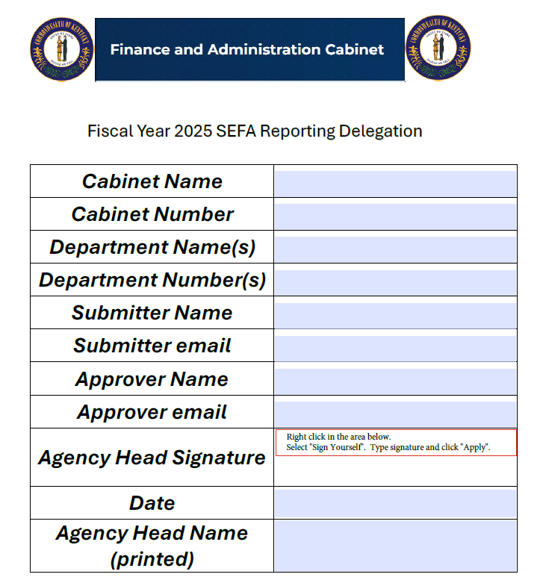
Important SEFA Reporting Dates
May 01 Delegation Reporting Form aka Delegation Authority
May 10 Delegation Form due to SEFA Team with FAC
June 30 Fiscal Year end
July 10 Period 12 is HARD CLOSED
August 15 Submitter must have all Workiva Tasks completed and sent to Approver
August 22 Approver must have all Workiva Tasks completed Approval
August 25 FAC begins SEFA review
Review for accuracy prior to submission. If your submission contains reconciling errors, the submission will be rejected through Workiva for correction. An email will generate from Workiva, creating a new task.

Slide 13
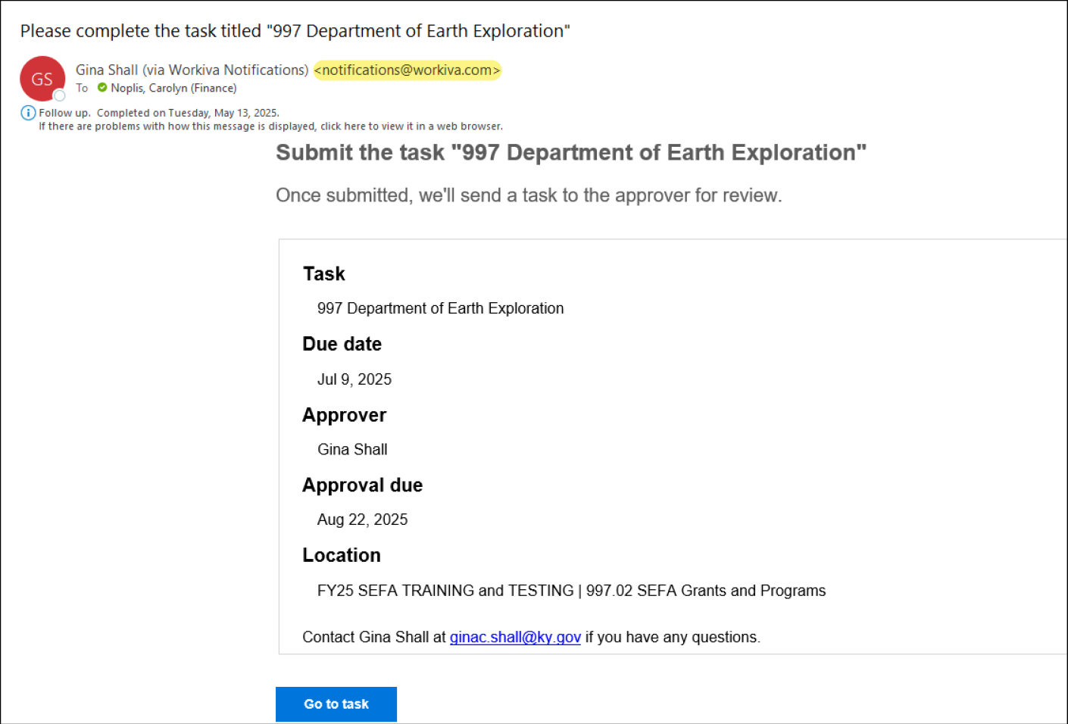
Submitter receives email from Workiva
Select the button

Slide 14
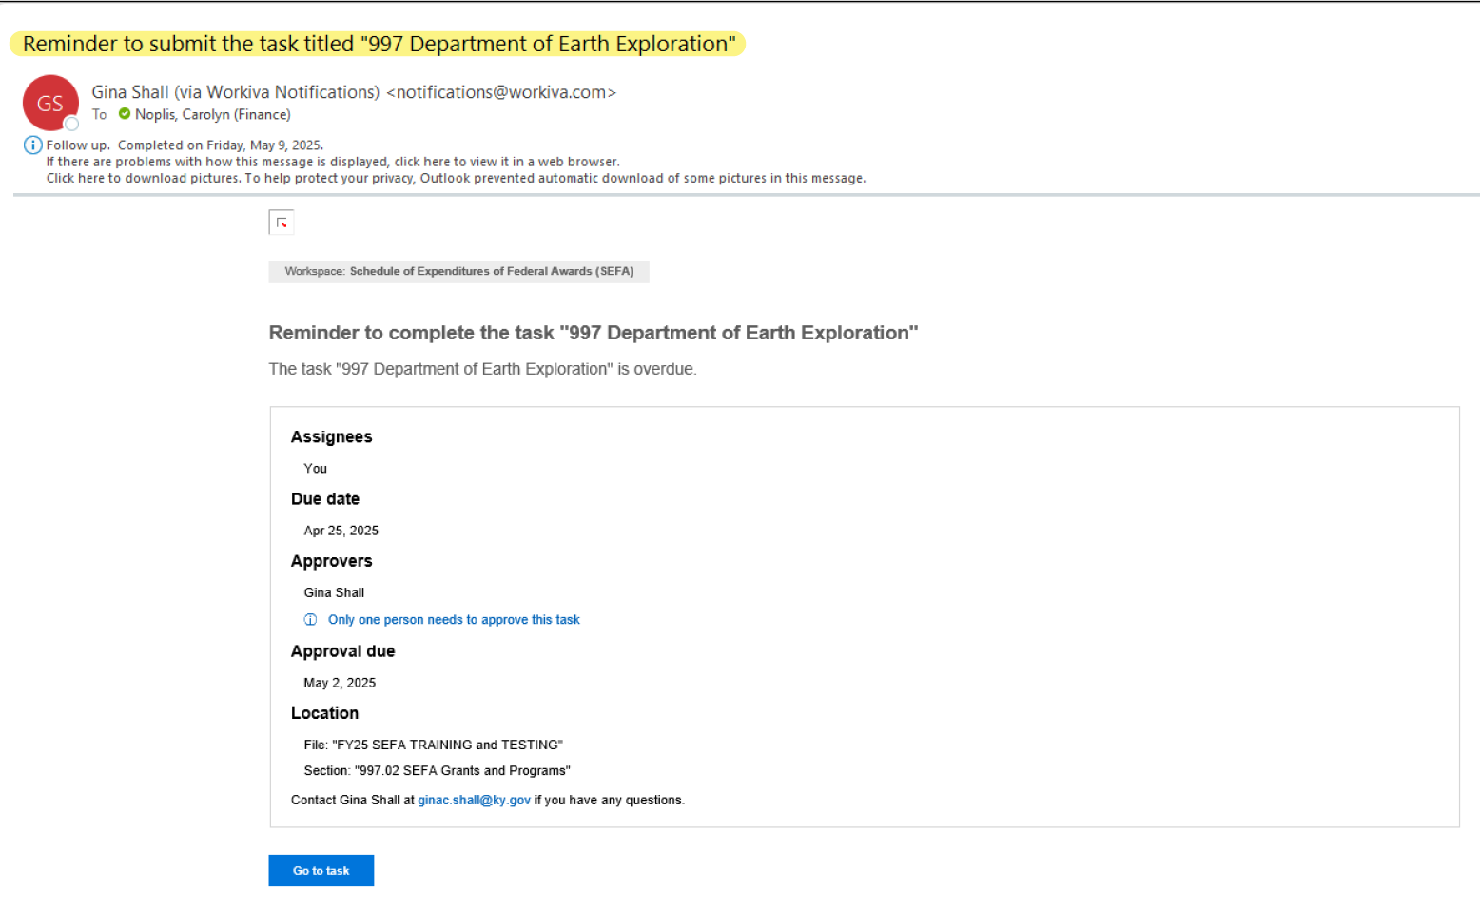
Reminder email task not complete
Should the task not be completed in 7 days, an email reminder is sent from Workiva.

Slide 15
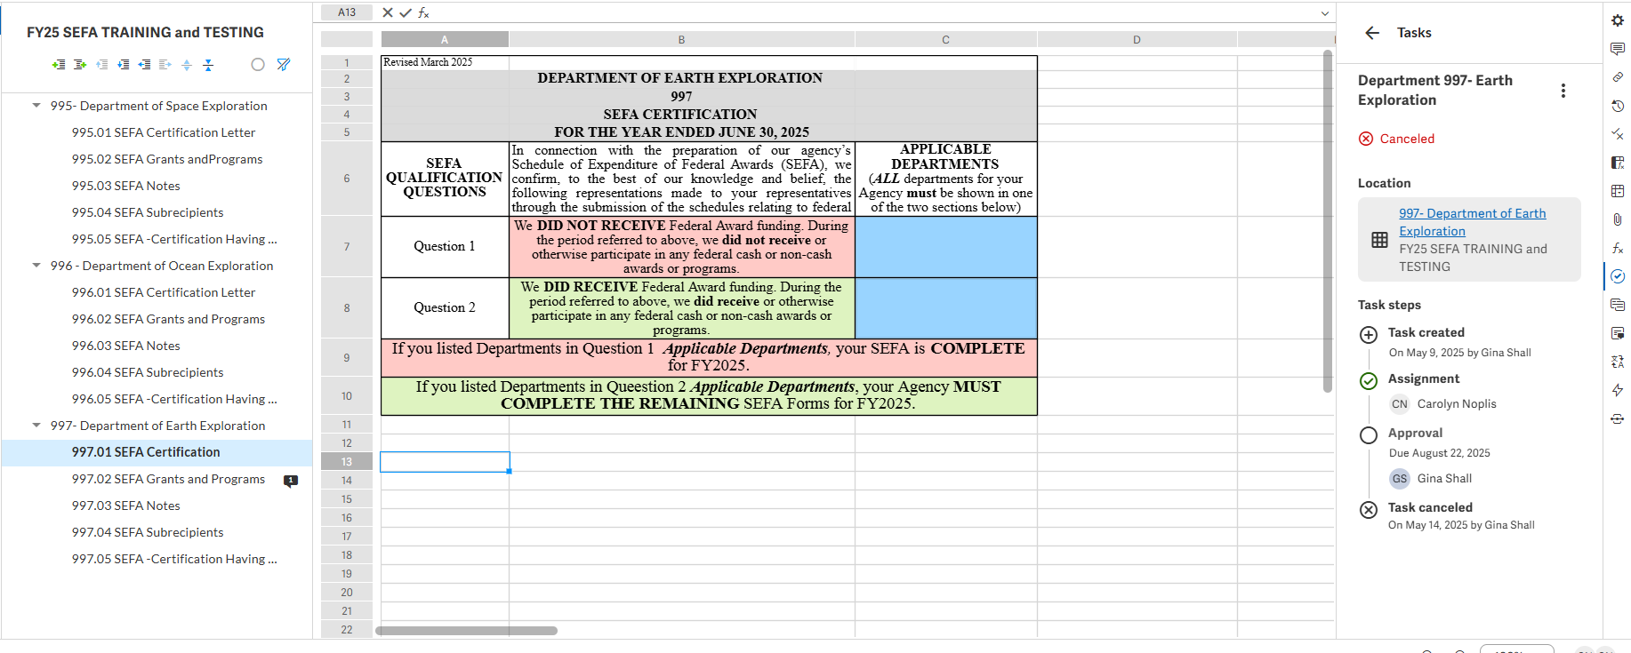
Welcome to Workiva Home of SEFA reporting

Slide 16
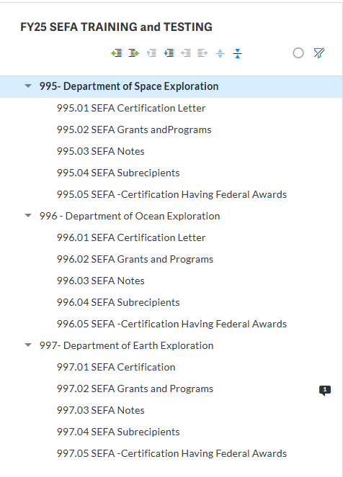
SEFA Contains 5 Worksheets
01 SEFA Certification Letter
02 SEFA Grants and Programs
03 SEFA Notes
04 SEFA Subrecipients
05 SEFA Certification Having Federal Awards

Slide 17
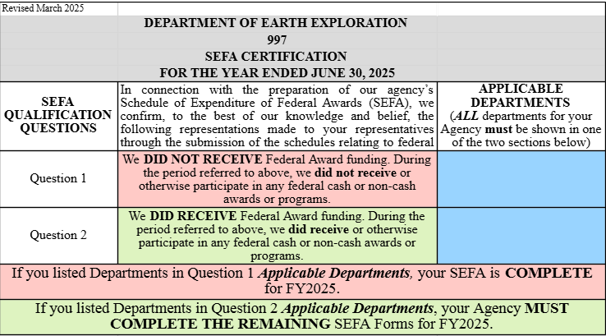
01 SEFA - Certification Letter

Slide 18
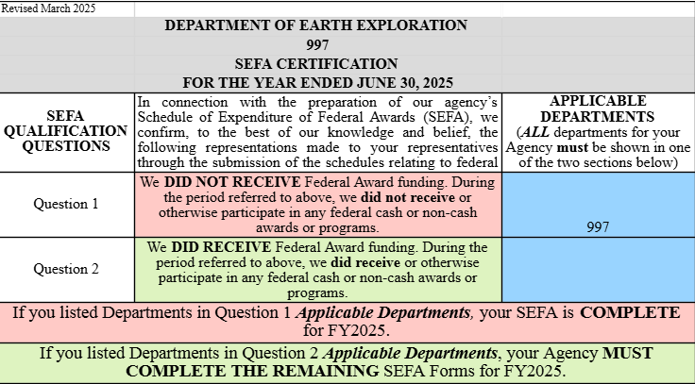
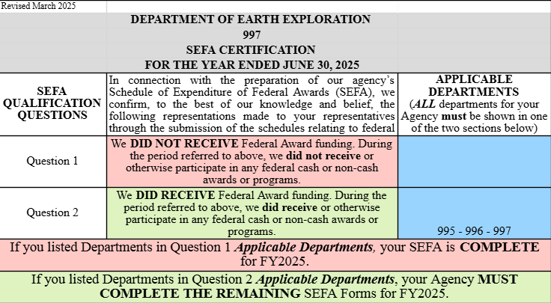
01 SEFA Certification Letter
Question 1 and 2 – How to answer
QUESTION #1 – NO federal awards received
QUESTION #2 – YES, federal awards received

Slide 19
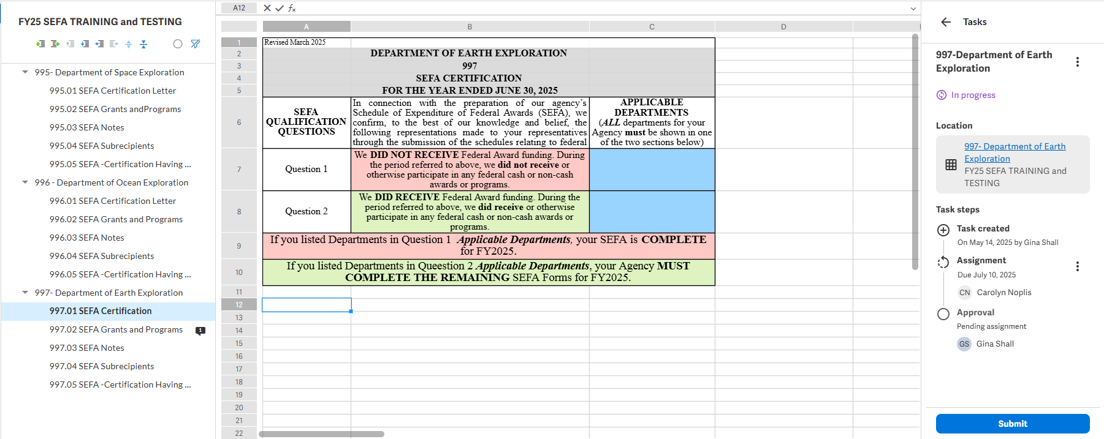
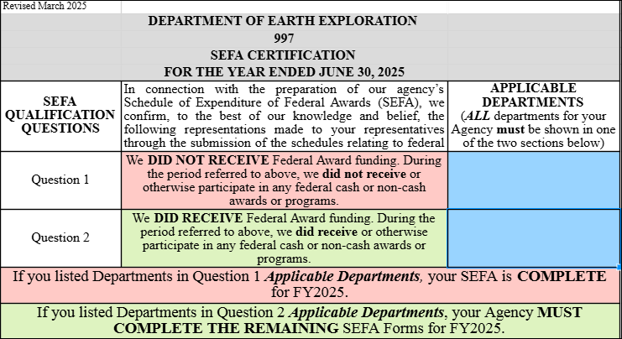
01 SEFA – Submit for Approval

Slide 20
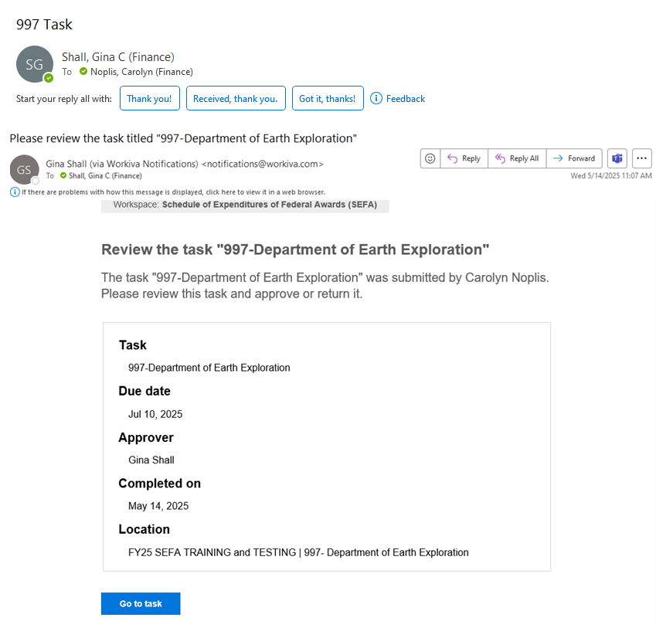
Approver receives email from “notifications@workiva.com”

Slide 21
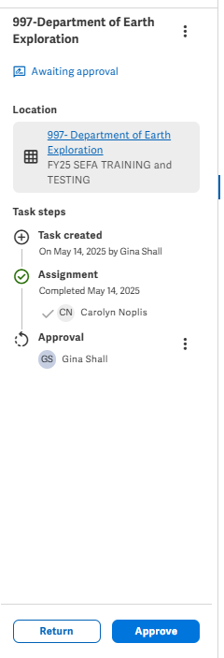
Approver reviews 01 SEFA for accuracy
The Approver will review the 01 SEFA Certification Letter for accuracy. The Approver will select the “Approve” button in Workiva to submit the approved 01 SEFA. This button is in the “Tasks” area on the right side of the Workiva screen.

Slide 22
IF your Agency did NOT receive Federal Awards for Fiscal Year 2025, as shown in the previous example, AND you HAVE SUBMITTED THE 01 SEFA AND the Approver has approved your submission, your Agency has completed the SEFA for FY25.
Feel free to EXIT the training once we have concluded the Q&A Session of this section of training.

Slide 23
Q&A Session
ginac.shall@ky.gov
carolyn.noplis@ky.gov

Slide 24
Important definitions for SEFA R&D ~ Pass-through ~ Grantor ~ Subrecipients
Research & Development - defined as all research activities, both basic and applied, and all development activities performed by a non-federal entity. This definition encompasses both the systematic study to gain scientific knowledge (research) and the systematic use of that knowledge to produce useful materials, devices, systems, or methods (development).
Pass-through FROM - In the context of financial reporting for federal grants, "pass-through from” refers to a federal award that an organization receives from a non-Federal entity (like a state or local government) instead of directly from a Federal agency.
Pass-through TO - In the context of financial reporting, especially within the SEFA, "pass-through to” refers to federal funds that are received by one organization and then distributed to another organization to carry out a federal program. These funds are not spent directly by the receiving entity but are passed on to a subrecipient who then performs the work required by the federal grant.
Subrecipient vs Vendor - a subrecipient is an entity that receives a portion of a federal award to carry out part of the program, while a vendor is an entity that provides goods or services in support of the program. A subrecipient is subject to compliance requirements of the federal program, while a vendor is not.
Paid to Grantor – Expired grant funds returned to the Grantor.

Slide 25
Research & Development (R&D)
All federal programs with research and development expenditures, as defined in the 2 CFR Section 200.87, should be reported.
Explain how the Department determined the research and development expenditures.
If the research and development expenditures are coded in eMARS, please indicate appropriate codes for each federal program.
If the research and development expenditure amounts are determined, or accounted for, outside of eMARS, please provide a detailed explanation of the process.
Example R&D Explanation

Slide 26
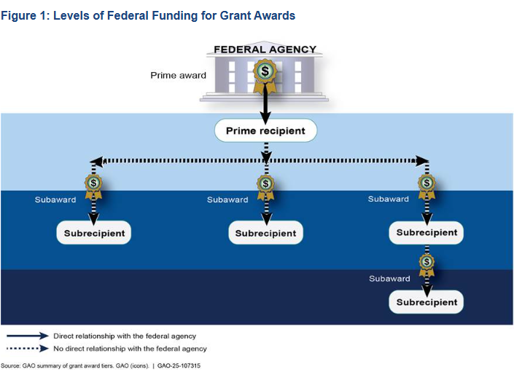
Federal Funding Grant Award Example Pass-throughs: KDE To DOC, DJJ & CHFS
Pass-through TO:
KDE
1. KDE receives Federal Award from US DOE and records as COLLECTED REVENUES Column G, SEFA 02.
2. KDE will show the expenditure in the CASH Passed-through TO, Column L, for all Departments, listed by ALN.
3. KDE records this Pass-through TO, SEFA 03, Note 4 section, listed numerically by ALN.
Pass-through FROM:
DOC, DJJ & CHFS
Each Department receives funds from KDE records as CASH Passed-through FROM Column K, SEFA 02.
Each Department will show the expenditures in the CASH EXPENDITURES, Column H, SEFA 02.
Each Department records this Pass-through FROM, SEFA 03, Note 3 section, listed numerically by ALN.
US Dept of Education
Kentucky Dept of Education (Dept 540)
Kentucky Department of Corrections (Dept 527)
Kentucky Department of Juvenile Justice (Dept 523)
CHFS (Cabinet of Health and Family Services (Dept 721)

Slide 27
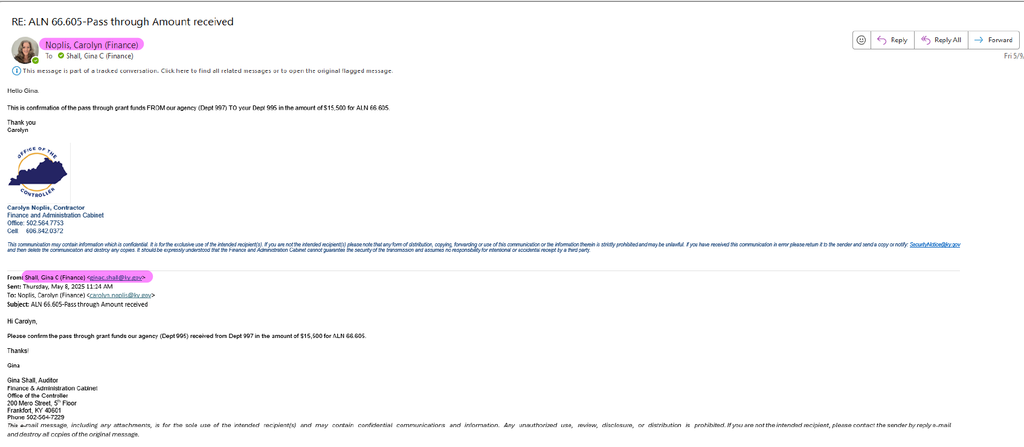
Pass-through communication between Agencies

Slide 28
Determining Federal Award Relationship
and
Reporting Requirements
STEP 1 - Are you the PRIME RECIPIENT¹ of the Federal Award?
Yes → Proceed to Step 2
STEP 2 - Determine the APPROPRIATE RELATIONSHIP CLASSIFICATION
Subrecipient²
No → Reference the "Pass-through Example" and stop
Vendor³
STEP 3 - If Subrecipient²
Is the entity a STATE AGENCY?
Yes → Proceed to Step 4
No →
✅ Report activity in the appropriate Expenditure Column AND the Subrecipient Column
STEP 4 - Is the entity a COMPONENT UNIT⁴?
Yes →
✅ Report activity in the appropriate Expenditure Column AND the Subrecipient Column
No →
✅ Report the activity as a Pass-through To the entity
If Vendor³
✅ Report activity in the appropriate Expenditure Column

Slide 29
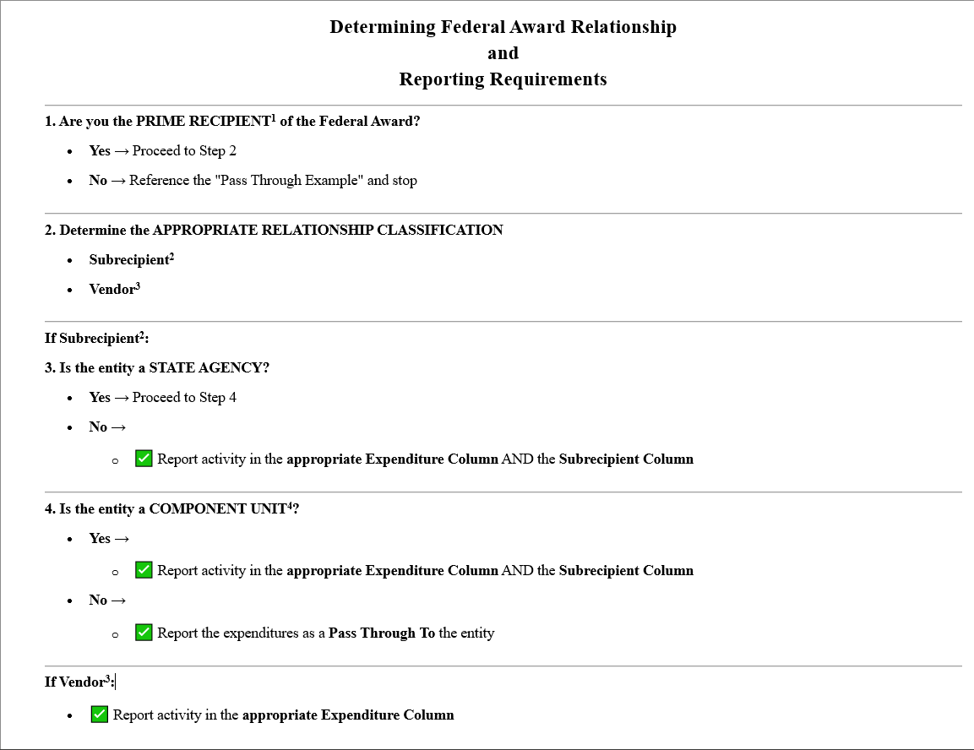

Slide 30
Relationship Notes and Definitions
Notes:
2 CFR 200.86 - Recipient means a non-Federal entity that receives a Federal award directly from a Federal awarding agency to carry out an activity under a Federal program. The term recipient does not include subrecipients.
2 CFR 200.93 - Subrecipient means a non‐Federal entity that receives a sub award from a pass‐through entity to carry out part of a Federal program; but does not include an individual that is a beneficiary of such program. A subrecipient may also be a recipient of other Federal awards directly from a Federal awarding agency.
2 CFR 200.22 – Vendor an entity that provides goods or services needed to carry out the project or program under a Federal award.
Component Unit Definition (CU) and List – In the state of Kentucky, a Component Unit is a legally separate organization that is included in the financial reporting entity of another governmental unit (the "primary government"). A list of Component Units are shown on the next 3 slides. The information is available to ALL Agencies on the FAC website.

Slide 31
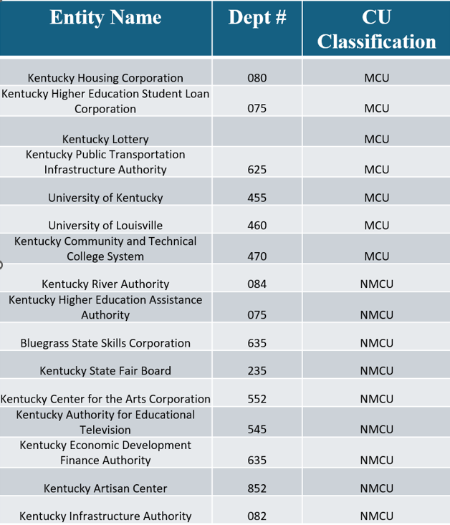

Slide 32
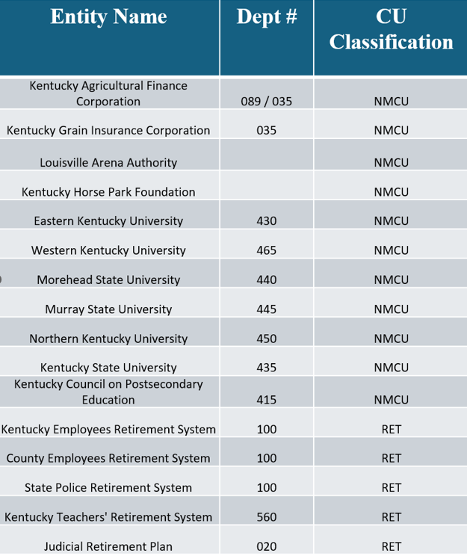

Slide 33
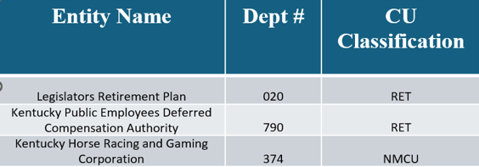

Slide 34
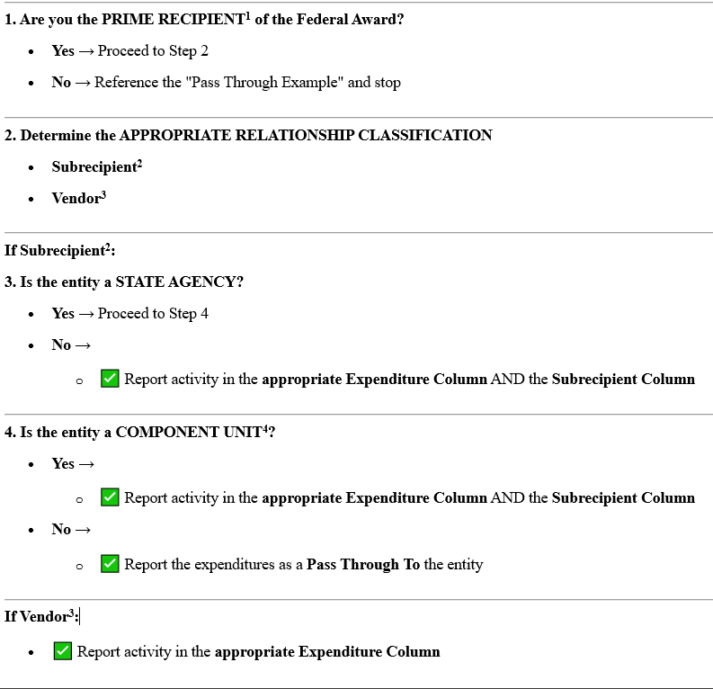
Example of Subrecipient Relationship Test

Slide 35
Example of Vendor Relationship Test

Slide 36
Assistance with Determining Federal Award Relationship
and
Reporting Requirements
Making the relationship determination(s) can be confusing.
We recognize this challenge, as there are multiple scenarios with individual nuances. We have covered only one hypothetic example.
The dates and names have been changed to protect the innocent.
If you are having difficulty making these relationship determinations, contact a member of the SEFA Team for assistance.
SEFA Team Contacts:
ginac.shall@ky.gov
carolyn.noplis@ky.gov

Slide 37
ginac.shall@ky.gov
carolyn.noplis@ky.gov

Slide 38
Paid to Grantor
Grant recipients are responsible for returning unspent or excess funds to the Grantor within a specified timeframe after the award period ends. Recipients may also elect to return funds before that time.
There are specific steps necessary to complete this return of funds. Please include this documentation with your SEFA submission to FAC.

Slide 39
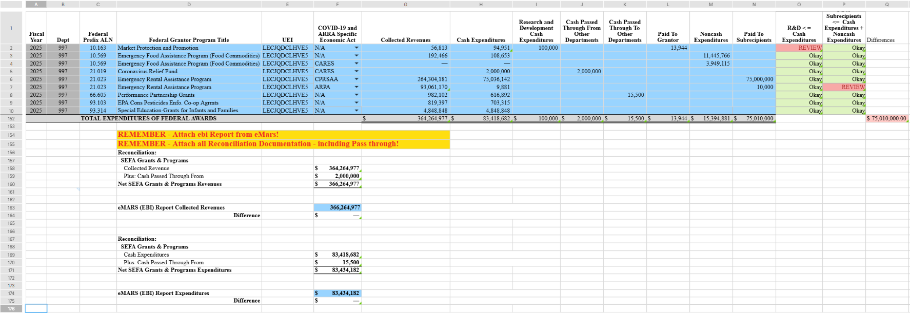
02 SEFA Grants and Programs

Slide 40
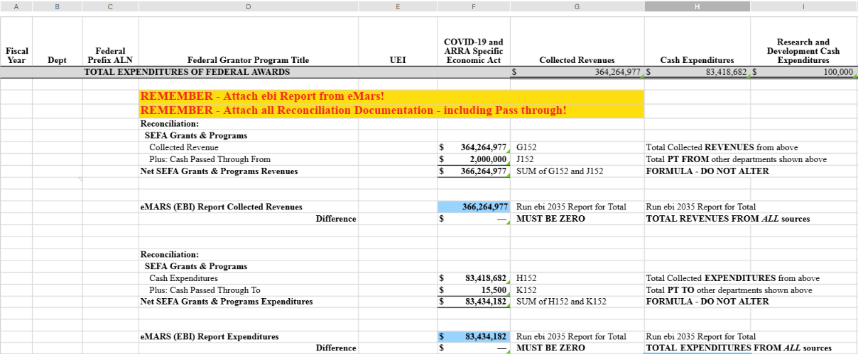
Reconciliation of SEFA Revenues and Expenditures to eMARS SEFA reporting – Collected Revenues and Cash Expenditures (2035 Report)

Slide 41
Reconciliation Links in Workiva

Slide 42
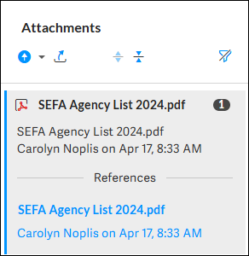
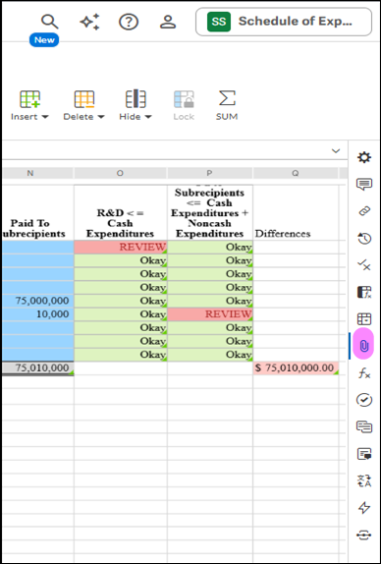
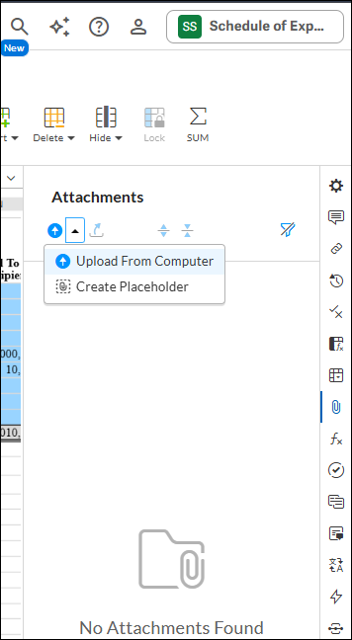
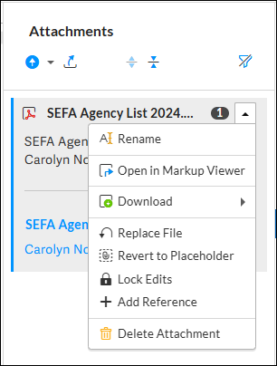
Attaching reconciliation documentation 02 SEFA

Slide 43
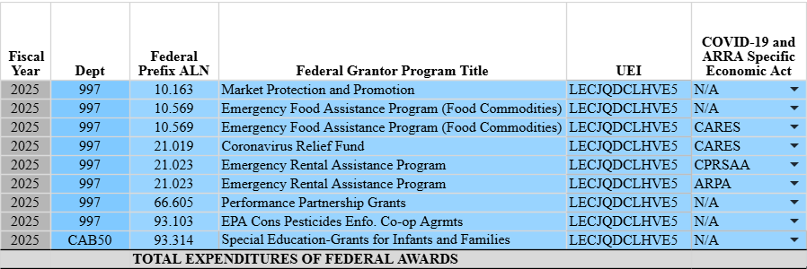
02 SEFA Department Identification when reporting at the Cabinet Level

Slide 44
Formatting options available on the top ribbon
Similar to EXCEL

Slide 45
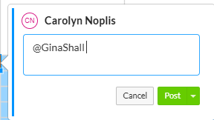
Adding comments to Workiva cells – use the “@” symbol to trigger an email be sent to the Workiva user

Slide 46
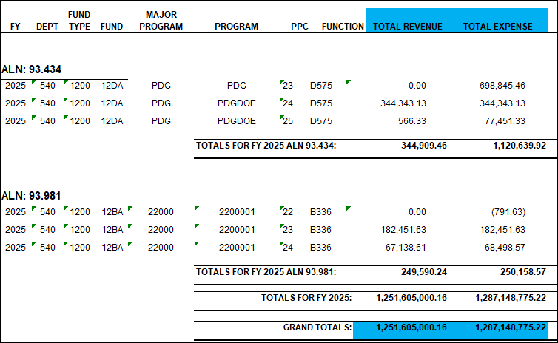
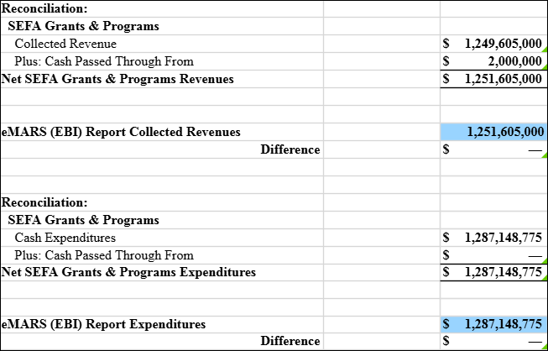
Reconciliation of SEFA to eMARS
**THE SEFA REPORTING TEAM IS AVAILABLE TO CLARIFY OR OTHERWISE ANSWER QUESTIONS DURING THE SEFA REPORTING PROCESS**
The reconciliation below reflects the automatic population of the reconciliation fields:
Below is an example of a 2035 Report:

Slide 47
02 SEFA Grants and Programs

Slide 48
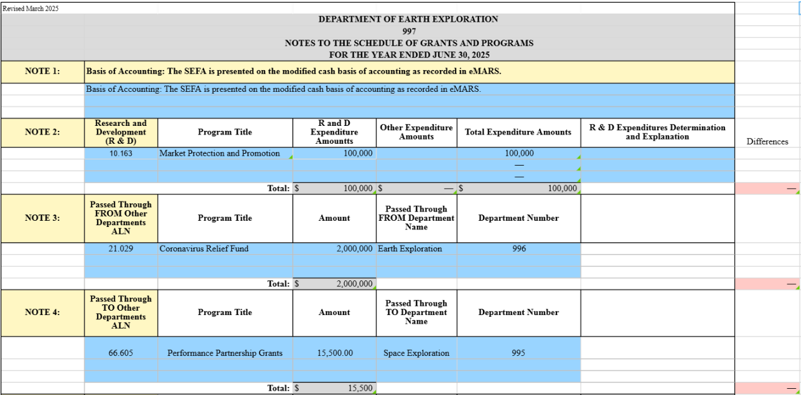
03 SEFA Notes Note 1 through 4
Review system assurance check total. Formulas exist to check the SEFA 03 entries against the entries made on the
SEFA 02.

Slide 49
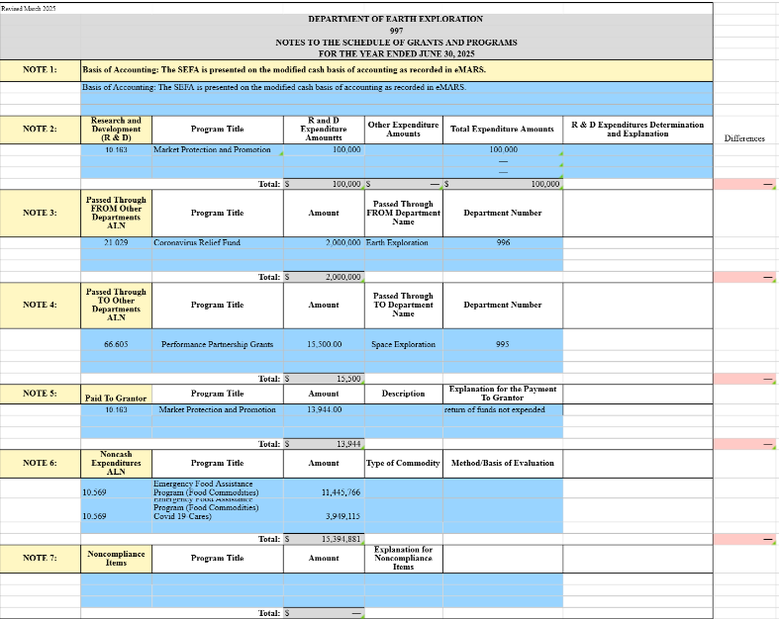
03 SEFA Notes Note 2: Research & Development (R&D)

Slide 50
03 SEFA Notes NOTE 3: Passed-through FROM NOTE 4: Passed-through TO

Slide 51
03 SEFA Notes Note 5: Paid to Grantor Note 6: Noncash Expenditures ALN Note 7: Noncompliance Items

Slide 52
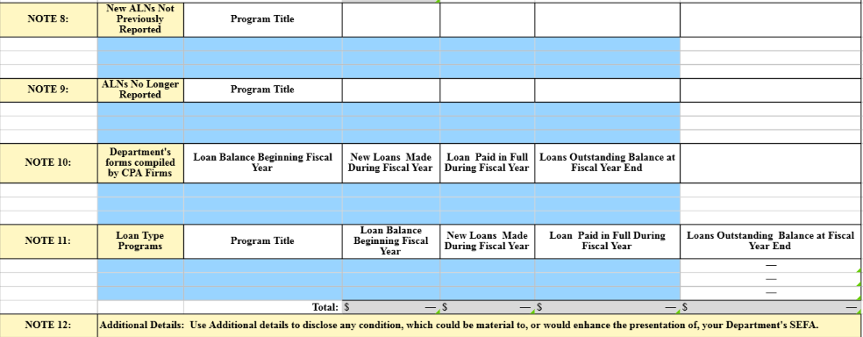
03 SEFA Notes
Note 8: New ALNs not previously reported Note 9: ALNs no longer reported Note 10: Department forms compiled by CPA firms Note 11: Loan Type Programs Note 12: Additional Details

Slide 53
03 SEFA NOTES
Questions?

Slide 54
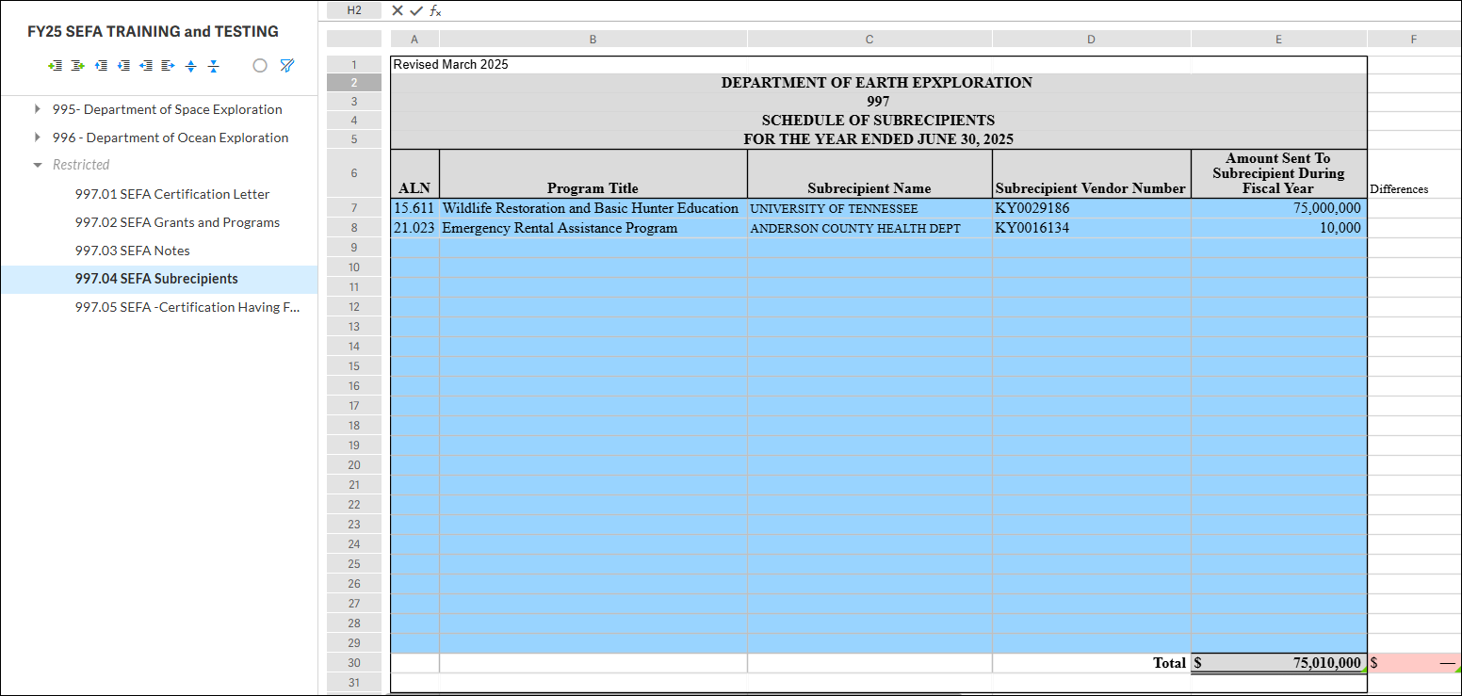
04 SEFA Subrecipients

Slide 55
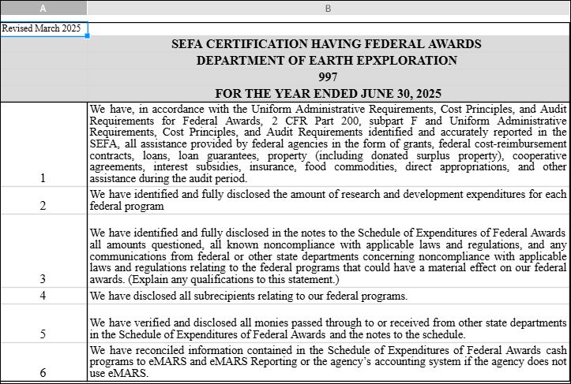
05 SEFA Certification Having Federal Awards

Slide 56
Homeland Security Grant Funding (Identified as SEFA 07)
The Homeland Security Grant Funding SEFA 07 is necessary to comply with reporting provisions contained in KRS 39G.020. Further, the SEFA 07 requires some additional information needed for report submission to the state legislature. All state and local departments must provide this additional federal grant data for each of the Homeland Security ALN numbered programs for which they have received a grant award. These programs must be reported regardless of expenditures made against the Homeland Security Funded Grant Awards during the reporting period. Complete SEFA 07 for any grant awards against the listing of ALN numbers but DO NOT REPORT grant funds received from the KY Office of Homeland Security.
SEFA 07 Form and Instructions can be found on the Office of the Controller’s website and must be submitted directly to the Kentucky Office Of Homeland Security.
https://finance.ky.gov/office-of-the-controller/Pages/default.aspx

Slide 57
Resources and Reference Guides
Office of the Controller’s Website:
https://finance.ky.gov/office-of-the-controller/office-of-statewide-accounting-services/financial-reporting-branch/Pages/schedule-of-expenditures-of-federal-awards.aspx
Component Unit List: 2025 CU LIST.docx
Relationship Test: Determining Federal Award Relationship and Reporting Requirement.docx
2025 SEFA Instructions: 2025 SEFA Instructions (Agency Instructions).docx
SEFA Training Presentation: FISCAL YEAR 2025 SEFA Reporting Training 07.10.2025.pptx
Primary Contacts: ginac.shall@ky.gov carolyn.noplis@ky.gov

Slide 58
SEFA reporting process

